Slide 1
KAVERI 3.0 · DEPARTMENT OF STAMPS AND REGISTRATION, GOVERNMENT OF KARNATAKA
Valuation Module (CVC)
Business Requirements Document — Executive Walkthrough
General Revision · Individual Project Guidance Value Fixation · Guidance Value Publication
Document ID: BRD-K3-CVC-GVF-001 · Version 8 · Status: Draft · Last updated 30-09-2026

Slide 2
LEGAL & REGULATORY REFERENCE
2
Applicable Acts
The Department of Stamps and Registration, through the IGR as Chairman of the Central Valuation Committee, administers the following Acts.
KSA
The Karnataka Stamp Act, 1957
Sec. 2(ac) defines CVC; Sec. 45-B constitutes CVC under IGR for estimation, publication and revision of market value guidelines and district / sub-district sub-committees; Sec. 45-A applies guidelines at registration; Sec. 3 + Schedule charge ad valorem duty. Strengthened by Act 8 of 2003 (w.e.f. 1-4-2003).
VALUATION MODULE (CVC) | BRD WALKTHROUGH · KAVERI 3.0
2

Slide 3
LEGAL & REGULATORY REFERENCE
3
Karnataka Stamp Act, 1957 — Key Sections
Section | Topic | BRD relevance
Sec. 2(ac) | Definition — Central Valuation Committee | CVC is the statutory owner of guideline rate masters and approvals
Sec. 45-B | Constitution of CVC; estimation, publication and revision of market value guidelines; district / sub-district sub-committees; CVC final authority for policy and methodology | Primary legal basis for General Revision and for fixation of guidance value for new individual projects (DR acceptance of citizen request under Sec. 45-B framework)
Relevant Rules
Rule / provision | Requirement
Stamp Act Sec. 45-B | CVC under IGR; publish and revise market value guidelines; constitute market valuation sub-committees
CVC Rules 2003 — Rule 5 | CVC instructions; notice of intention; 15-day objections; signed statement of average rates (booklet + soft copy) to DR; DR verification and 15-day rectification
CVC Rules 2003 — Rule 7 | CVC Secretary verification; CVC decision on Sub-Committee / DR suggestions; attestation; publication in offices; printed copies for sale
Related notifications / amendments
• Act 8 of 2003 (w.e.f. 1-4-2003) — Substituted / strengthened Sec. 45-B CVC framework
• CVC instructions to Sub-Committees — Rule 5(1) (per revision cycle: yearly or mid-year) — Triggers General Revision; CVC approves statements (Rule 7); gazette fixes effective date
VALUATION MODULE (CVC) | BRD WALKTHROUGH · KAVERI 3.0
3

Slide 4
LEGAL & REGULATORY REFERENCE
4
Definitions and Glossary
Term | Definition
Guidance / Guideline value | Market value guideline rate published under Sec. 45-B for a territorial unit (village / road / survey / project / property class); used for stamp-duty
CVC | Central Valuation Committee as defined in Sec. 2(ac) and constituted under Sec. 45-B.
General Revision | Cycle to estimate / revise market value guidelines for the next calendar year, triggered by CVC instructions to Sub-Committees (Rule 5(1)); includes mid-year revision for specific Sub-Committees.
Individual Project Fixation | Fixation of guidance value for a newly developed property / project on citizen or party application, accepted by DR under Sec. 45-B.
Sub-committee | Market Valuation Sub-Committee (Rule 4) headed by the Tahsildar, with the Sub-Registrar as Member Secretary.
Effective date | Date fixed by CVC / gazette from which new guidance rates are adopted in Kaveri for calculation and display.
Public opinion period | Fifteen (15) days for public objections / suggestions after the Sub-Committee’s notice of intention (Rule 5(2)).
Notice of intention | Sub-Committee notice in local newspapers and office notice boards announcing its plan to estimate / revise market values (Rule 5(2)).
Statement of average rates | Signed Sub-Committee statement of average rates (agricultural land; residential, commercial, industrial sites), village-wise and local-body-wise; sent as booklet + soft copy.
Rectification period | Fifteen (15) days from the District Registrar’s reference to correct and resubmit the statement (Rule 5(3)).
Attested statement | CVC-approved statement attested by the CVC Secretary and sent to DR and Sub-Committees for publication (Rule 7(3)).
VALUATION MODULE (CVC) | BRD WALKTHROUGH · KAVERI 3.0
4

Slide 5
LEGAL & REGULATORY REFERENCE
5
Central Valuation Committee — Composition
Karnataka Stamp (Constitution of Central Valuation Committee for Estimation, Publication and Revision of Market Value Guidelines of Properties) Rules, 2003 — Rule 3
CHAIRMAN
MEMBER SECRETARY
STRENGTH
Commissioner of Stamps (IGR)
DIGR (Valuation)
Total members ≤ 20
Members — one representative from each of the following
(i) Directorate of Town Planning
(ii) Directorate of Survey and Settlement
(iii) Bangalore City Corporation
(iv) Bangalore Development Authority
(v) Income-tax Department
(vi) Karnataka Public Works Department
(vii) Karnataka Irrigation Department
(viii) Registration and Stamps Department
(ix) Institute of Chartered Valuers
(x) Federation of Karnataka Chamber of Commerce and Industries
(xi) Any other person having expertise in the subject
Non-official members: term of two years, subject to the pleasure of the Government. Member Secretary (DIGR–Intelligence) handles day-to-day administration, correspondence, and compilation / publication of market value guidelines.
VALUATION MODULE (CVC) | BRD WALKTHROUGH · KAVERI 3.0
5

Slide 6
LEGAL & REGULATORY REFERENCE
6
Market Valuation Sub-Committees — Composition
Karnataka Stamp (Constitution of C.V.C. etc.) Rules, 2003 — Rule 4 · Constituted by CVC for each sub-district and district for estimation & revision of market value guidelines
HEAD (SUB-DISTRICT)
MEMBER SECRETARY
OFFICE
Tahsildar of the concerned taluk
Sub-Registrar of the sub-district
Office of the Sub-Registrar
Members drawn from
Administrative & supervisory control
• Department of Revenue
• Department of Survey and Settlement
• Public Works Department
• Municipal Councils or Town Panchayaths
Administrative control
Registrar of the district
Supervisory control
Central Valuation Committee
District Sub-Committees
Function under the Registrar of the district
Sub-Registrar (Member Secretary) looks after administration of the Sub-Committees, correspondence, and compilation of market-value data as per Sub-Committee resolutions. CVC office (Rule 3): Office of the Inspector General of Registration and Commissioner of Stamps, or such other place as the Committee decides.
VALUATION MODULE (CVC) | BRD WALKTHROUGH · KAVERI 3.0
6

Slide 7
LEGAL & REGULATORY REFERENCE
7
Guidelines for Estimating Guidance Value
Karnataka Stamp (Constitution of C.V.C. etc.) Rules, 2003 — Rule 6. Average-rate factors for Sub-Committee statements — also the evidence checklist when proposing new guidance value. Tags (#) show where data can be extracted electronically.
Lands — R.6(1)(a)
House sites — R.6(1)(b)
Other properties — R.6(1)(c)
Rate suggestions — R.6(2)
• Dry / garden / wet classification
• Soil class in survey records
• Other valuation influencers
• Value of adjacent / vicinity lands
• Crop nature & 5-year avg. yield
• Nearness to road & market
• Distance from village; location; level
• Transport & irrigation facilities
• General locality site values
• Proximity to road / rail / bus
• Proximity to market & shops
• Offices, hospitals, schools
• Development / industrial activity
• Land tax & local body valuation
• Other material / special features
• Nature & condition of property
• Purpose for which used
• Any other special valuation features
• Non-agri / industrial: agri multiple or per sq.ft
• Agricultural: dry / wet / garden + village proximity
• Plantations: treat as garden lands
• Buildings: PWD construction norms
• Civic amenities in construction cost
e-Source / Department
e-Source / Department
e-Source / Department
e-Source / Department
#Bhoomi/RTC #SSLR #KSRSAC-GIS #Agriculture #Irrigation #Kaveri-Regn #DTCP
#Kaveri-Regn #KSRSAC-GIS #ULB/e-Aasthi #DTCP/BDA/UDA #Transport
#Kaveri-Regn #ULB-BldgPlan #Khata #KSRSAC-GIS
#Bhoomi #PWD-SoR #Horticulture #BESCOM/ESCOM #BWSSB/ULB
Evidence for proposing new guidance value · Electronic extraction map
Rule 6 factors = statutory checklist for Sub-Committee statements and for evidence packs on General Revision / Individual Project proposals (BRD 7.ii.d / 7.iii.c). Primary e-feeds (as available): Kaveri registration transactions · Bhoomi/RTC & SSLR survey · KSRSAC GIS layers · ULB khata / property tax (e-Aasthi) · DTCP / BDA / UDA planning · PWD Schedule of Rates · Agriculture / Horticulture / Irrigation dept. systems · utility masters (BESCOM/ESCOM, BWSSB/KUWSDB). Registrar verifies statements (15-day rectification); booklets / soft copies to Secretary, CVC in first week of January.
VALUATION MODULE (CVC) | BRD WALKTHROUGH · KAVERI 3.0
7

Slide 8
PEOPLE & SYSTEMS
8
Stakeholders and Actors
IGR
IGR / Chairman CVC
DIGR
DIGR (Valuation) / Secretary CVC
DR
District Registrar
SR
Sub-Registrar
SC
Market Valuation Sub-committee
Chairs CVC; CVC instructions to Sub-Committees start General Revision (Rule 5(1)); approves final value for individual projects.
CVC Secretary: checks DR statements and places them before CVC (Rule 7(1)); attests approved statements (Rule 7(3)); reviews individual-project proposals.
Checks Sub-Committee statements; returns mistakes for 15-day rectification; sends booklets to CVC Secretary; forwards attested statements; accepts Sec. 45-B requests.
Sub-Committee Secretary: publishes notice of intention; sorts objections; prepares and co-signs the statement; sends booklet + soft copy to DR.
Tahsildar (Chairman), SR (Secretary), Revenue, Survey, PWD, local bodies: considers objections, decides rates, signs statement, publishes approved rates.
CVC
Central Valuation Committee
C/P
Citizen / Party / Developer
IT
Kaveri IT Cell / System Admin
Issues instructions (Rule 5(1)); discusses district-wise rates, accepts / rejects suggestions, records decisions (Rule 7(2)); fixes sale price and effective date.
Applies for individual project fixation (with ULPIN); files objections within 15 days of the notice of intention; may buy approved statements.
Maintains Valuation Module; publishes approved rates from effective date; integrations (KSRSAC, RTC, etc.).
VALUATION MODULE (CVC) | BRD WALKTHROUGH · KAVERI 3.0
8

Slide 9
FUTURE STATE (TO-BE)
9
Two Guidance Value Fixation Paths in Kaveri 3.0
Kaveri 3.0 provides an end-to-end Valuation Module workbench. Approved rates are versioned, gazette-linked, and activated only from the notified effective date.
A
Process A — General Revision
B
Process B — Individual Project Fixation
Estimation / revision of guidance values for the next calendar year (Rules 5 and 7), triggered by CVC instructions to Sub-Committees: notice of intention → 15-day objections → signed Sub-Committee statement → DR verification → CVC Secretary → CVC decision → attestation and publication → effective date / e-Gazette → Kaveri adoption.
Citizen / party-initiated request for a newly developed property (ULPIN given; boundary fetched from ULMS), accepted by the District Registrar under Sec. 45-B: DR inspection → Secretary CVC review → Chairman CVC (IGR) approval → Kaveri adoption.
VALUATION MODULE (CVC) | BRD WALKTHROUGH · KAVERI 3.0
9

Slide 10
FUTURE STATE (TO-BE)
10
Details Captured for Each Valuation Area
For every valuation area, Kaveri 3.0 records the details below. They are used by both General Revision and Individual Project Fixation.
Detail | What is captured
Area / extent | Size of the valuation area in square metres
Location (geo-fence) | Geo-coordinates of the area boundary, mapped as a polygon. Used to identify the area on the map, overlay evidence (e.g. KSRSAC) and apply the correct rate.
Rate categories | Guidance rates under two categories: Non-Agricultural and Agricultural.
Non-Agricultural rates | Separate rates for Residential, Commercial and Industrial use.
Agricultural rates | Separate rates for Dry, Wet and Bhagayat land.
At a glance
Valuation area
Area / extent in m²
Geo-fence (boundary on map)
Guidance rates by category
Non-Agricultural
Agricultural
Residential
Dry
Commercial
Wet
Industrial
Bhagayat
Rate categories and types are maintained by CVC / DIGR Admin as masters, with English and Kannada labels, so new types can be added later.
VALUATION MODULE (CVC) | BRD WALKTHROUGH · KAVERI 3.0
10

Slide 11
7.I GENERAL REVISION
11
Channel / Trigger Model
Trigger: CVC (Chairman IGR) issues instructions and general policy guidelines to all Market Valuation Sub-Committees for the next calendar year (Rule 5(1)); CVC may also order any Sub-Committee to revise rates mid-year.
Officer Workbench Channel
Citizen / Public Portal Channel
CVC · CVC SECRETARY · DR · SUB-COMMITTEE · SR
VIEW · OBJECT · BUY · TRACK
Officer activities
Citizen / public activities
CVC instructions → notice of intention → 15-day objections → Secretary sorts objections → Sub-Committee decides rates → signed statement (booklet + soft copy) → DR check and 15-day rectification → CVC Secretary → CVC decision → attestation → publication and sale → effective date / e-Gazette → Kaveri adoption.
View the Sub-Committee’s notice of intention; file objections / suggestions within 15 days (online or at the SRO); view / download approved statements and buy printed copies; track cycle status.
Evidence used
Boundary
Rule 6 factors with historical registration (transaction) data, KSRSAC GIS / maps, developer publications, RTC data, khata data, town planning inputs — available on the Sub-Committee workbench.
Objections go to the Sub-Committee Secretary and Sub-Committee; their views are recorded in the signed statement. The portal does not propose or approve rates.
VALUATION MODULE (CVC) | BRD WALKTHROUGH · KAVERI 3.0
11

Slide 12
7.I GENERAL REVISION
12
Process Flow — General Revision (15 Stages + Kaveri Steps)
1
2
3
4
5
6
CVC
Sends instructions and guidelines to all Sub-Committees (yearly, or to one Sub-Committee mid-year)
Rule 5(1)
Sub-Committee
Announces the plan to revise rates in newspapers and on office notice boards
Rule 5(2)
Public
Sends objections or suggestions within 15 days
Rule 5(2)
Sub-Committee Secretary (SR)
Sorts objections and places them before the Sub-Committee
Rule 5(2)
Sub-Committee
Meets, considers public views and decides the new rates
Rule 5(2)
Sub-Committee
Prepares statement of average rates, village-wise and local-body-wise
Rule 5(2)
7
8
9
10
11
12
Chairman + Secretary
Sign the statement in CVC format, with views on objections
Rule 5(2)
Sub-Committee Secretary (SR)
Sends printed booklet and soft copy to the District Registrar
Rule 5(2)
District Registrar
Checks the statement; returns mistakes or missing data
Rule 5(3)
Sub-Committee
Corrects and resubmits within 15 days
Rule 5(3)
District Registrar
Final review with remarks; booklet per sub-district to CVC Secretary
Rule 5(3)
CVC Secretary
Checks the statements and places them before the CVC
Rule 7(1)
13
14
15
16
17
CVC
Discusses district-wise; accepts / rejects suggestions; records decisions
Rule 7(2)
CVC Secretary → DR
Attests approved statements; DR forwards them to Sub-Committees
Rule 7(3)
Sub-Committee / DR
Display approved rates in offices; printed copies sold at CVC price
Rule 7(3)
CVC + Kaveri
Fix effective date; publish e-Gazette via DIPR / Karnataka Rajya Patra
Kaveri system step
Kaveri System
New rates live from the effective date; old rates kept for history
Kaveri system step
Rows read left to right. Step 9 returns mistakes to step 10 (15-day rectification); step 13 can return to step 12 for clarification. Grey dashed boxes = Kaveri system steps (not in the Rule 5 / 7 text).
VALUATION MODULE (CVC) | BRD WALKTHROUGH · KAVERI 3.0
12

Slide 13
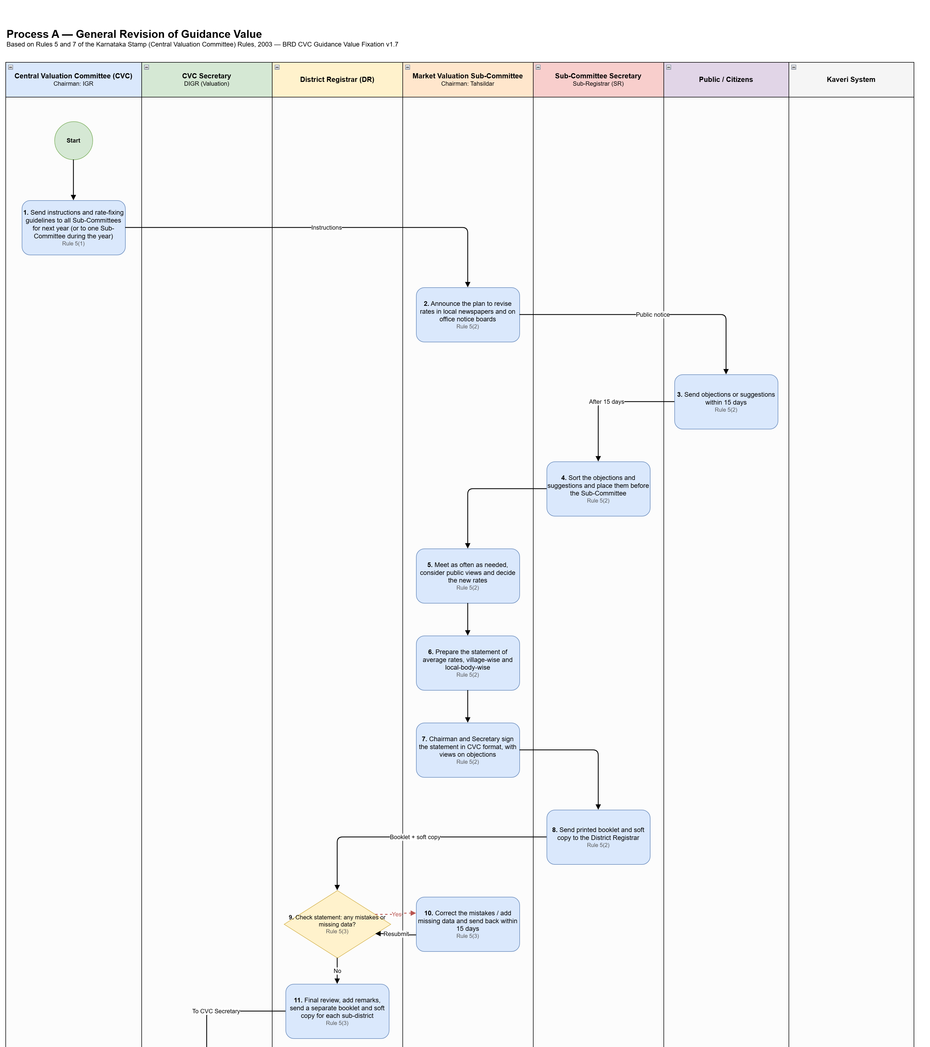
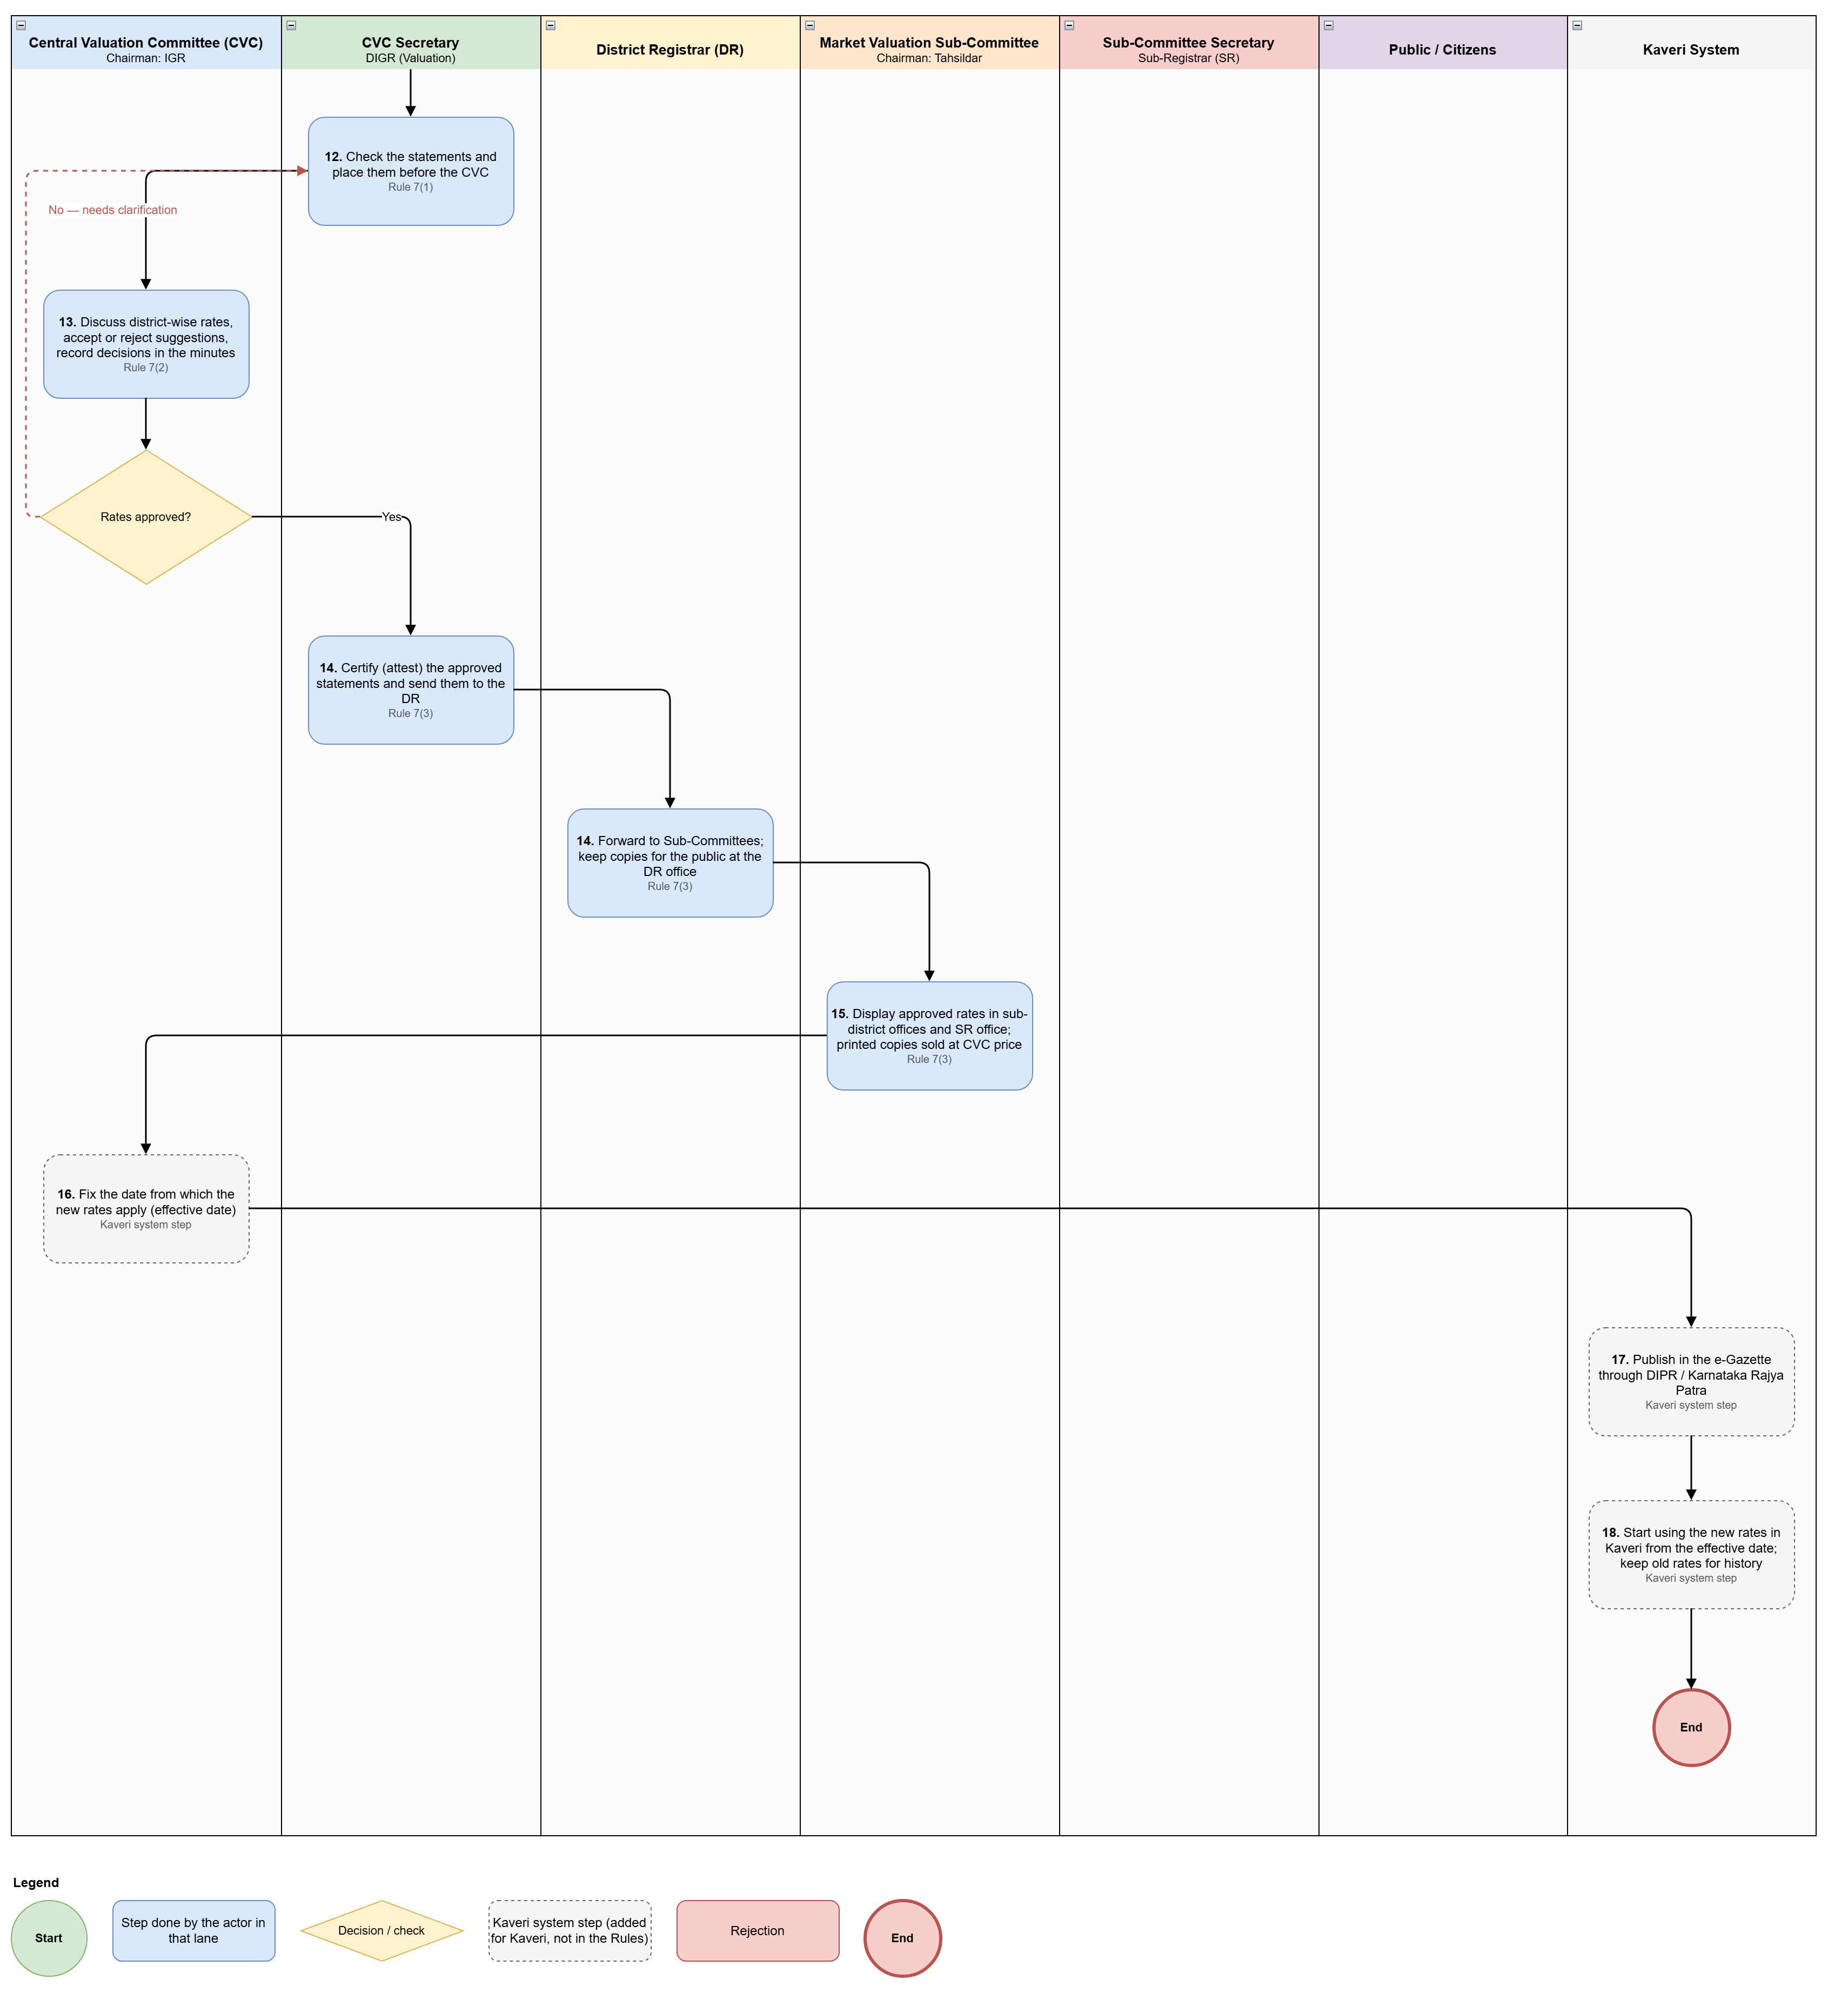
7.I GENERAL REVISION
13
Swimlane Process Diagram — General Revision
One lane per actor; flow runs top to bottom. Full-size: BRD v1.8 Figure 1 · Process Diagram/Process_A_General_Revision.drawio
Part 1 — Stages 1 to 11
Part 2 — Stages 12 to 15 and Kaveri steps
Lanes
CVC (Chairman: IGR)
CVC Secretary — DIGR (Valuation)
District Registrar
Market Valuation Sub-Committee (Chairman: Tahsildar)
Sub-Committee Secretary — SR
Public / Citizens
Kaveri System
Red dashed arrows = return paths (rectification; CVC clarification).
Grey dashed boxes = Kaveri system steps.
VALUATION MODULE (CVC) | BRD WALKTHROUGH · KAVERI 3.0
13

Slide 14
7.I GENERAL REVISION
14
Application / Cycle Status Model
Status | Meaning | Owner
Cycle Draft | Revision Cycle created; instructions being prepared | CVC Secretary
Instructions Issued | CVC instructions sent to Sub-Committees (general / mid-year) | CVC
Notice of Intention Published | Plan to revise published in newspapers / notice boards | Sub-Committee
Objections Open | 15-day objection / suggestion window running | Public / SC Secretary
Objections Under Processing | Secretary sorting objections for the agenda | SC Secretary (SR)
Sub-Committee Deliberation | Sittings in progress; rates being decided | Sub-Committee
Statement Signed | Statement signed by Secretary and Chairman | Sub-Committee
Submitted to DR | Booklet and soft copy with District Registrar | Sub-Committee / DR
Returned for Rectification | Mistakes returned; 15-day clock running | Sub-Committee
Status | Meaning | Owner
DR Final Examination | DR recording views on improvement / change | DR
With CVC Secretary | Per-sub-district booklets under verification | CVC Secretary
Placed before CVC | District-wise estimations on CVC agenda | CVC
Approved | Decision recorded; suggestions accepted / rejected | CVC
Attested and Transmitted | Attested statements sent to DR → Sub-Committees | CVC Secretary / DR
Published | Displayed in offices; printed copies on sale | Sub-Committee / DR
Gazette Linked | Effective date fixed; e-Gazette particulars captured | CVC / Admin
Active in Kaveri | Rates live from effective date | System
Returned / Clarification | Returned to prior stage with remarks | Prior owner
VALUATION MODULE (CVC) | BRD WALKTHROUGH · KAVERI 3.0
14

Slide 15
7.II INDIVIDUAL PROJECT FIXATION
15
Channel / Trigger Model
Trigger: party / citizen applies for fixation of guidance value for a newly developed property / project. Legal gate: District Registrar accepts the request under Sec. 45-B.
Citizen Portal — Online
DR Office Desk — Offline / Assisted
MODE: ONLINE
MODE: OFFLINE / ASSISTED
Citizen activities
Citizen activities
Apply for fixation of guidance value for the newly developed property with ULPIN (boundary fetched from ULMS), property particulars and project documents; track status online.
Application submitted at the DR office desk with assisted data entry where the citizen cannot use the portal directly.
Office activities
Office activities
DR accepts / returns for deficiency; spot inspection & proposal; Secretary CVC review & finalisation; IGR approval and Kaveri publication.
Same DR → Secretary CVC → IGR approval chain as the online channel; inspection report and evidence pack captured by DR staff.
VALUATION MODULE (CVC) | BRD WALKTHROUGH · KAVERI 3.0
15

Slide 16
7.II INDIVIDUAL PROJECT FIXATION
16
Process Flow — Individual Project Fixation (6 Steps)
1
2
3
4
5
6
DR accepts the request under Sec. 45-B (or returns for deficiency with reasons)
DR conducts spot inspection and proposes the guidance value (inspection report + proposed rate + evidence)
Secretary CVC reviews the proposal using the evidence pack and finalises the guidance value
Finalised guidance value submitted to Chairman CVC (IGR) for approval
IGR approves; rates published / linked to project or survey units and adopted in Kaveri per effective date
Party / citizen applies (application, ULPIN, property particulars, project documents); boundary fetched from ULMS
Key characteristics
District Registrar is the acceptance authority under Sec. 45-B; Chairman CVC (IGR) is the final approval authority. If Secretary CVC returns the proposal, DR retains full history and the citizen sees status and deficiency list.
VALUATION MODULE (CVC) | BRD WALKTHROUGH · KAVERI 3.0
16

Slide 17
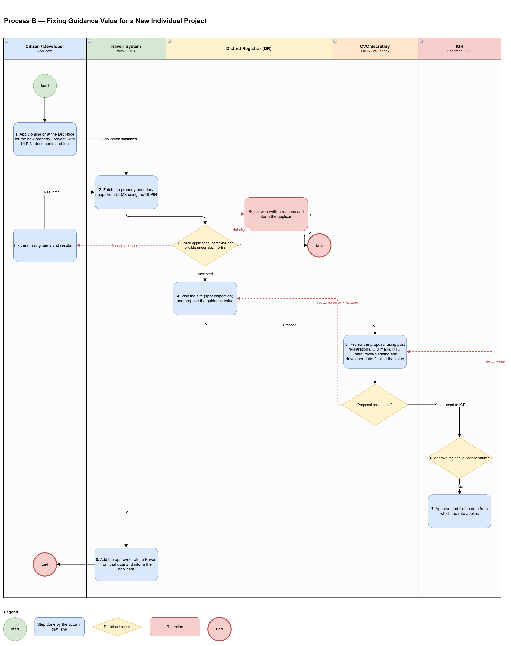
7.II INDIVIDUAL PROJECT FIXATION
17
Swimlane Process Diagram — Individual Project Fixation
One lane per actor; flow runs top to bottom. Full-size: BRD v1.8 Figure 2 · Process Diagram/Process_B_Individual_Project_Fixation.drawio
Reading the diagram
Lanes: Citizen / Developer · Kaveri System (with ULMS) · District Registrar · CVC Secretary · IGR (Chairman, CVC).
Kaveri fetches the property boundary from ULMS using the ULPIN.
DR check has three outcomes: accepted → site inspection; needs changes → applicant fixes and resubmits; not eligible → rejected with written reasons.
CVC Secretary can return the proposal to the DR with remarks; IGR can return it to the CVC Secretary.
On IGR approval the start date is fixed and the rate goes live in Kaveri; the applicant is informed.
VALUATION MODULE (CVC) | BRD WALKTHROUGH · KAVERI 3.0
17

Slide 18
7.II INDIVIDUAL PROJECT FIXATION
18
Application Status Model
Status | Meaning | Owner
Submitted | Citizen application filed | Citizen
Accepted by DR | Request accepted under Sec. 45-B | DR
Inspection Scheduled / Done | Spot inspection | DR
DR Proposed | DR proposal with proposed value | DR
Secretary CVC Review | Under review / finalisation | Secretary CVC
Pending IGR Approval | Submitted to Chairman CVC | IGR
Approved | IGR approved final guidance value | IGR
Active in Kaveri | Rate available for calculation / display | System
Returned for Deficiency | Citizen or DR must remedy | Prior owner
Rejected | Request rejected with speaking order | DR / IGR
VALUATION MODULE (CVC) | BRD WALKTHROUGH · KAVERI 3.0
18

Slide 19
7.III WHAT IS NEW
19
Highlights in Kaveri 3.0
1
Digitised General Revision cycle
2
Citizen-initiated Individual Project Fixation
3
Structured evidence for revision
CVC instructions → notice of intention → 15-day objections → signed statement → DR verification → CVC Secretary → CVC decision → attestation and publication → effective date → automatic adoption.
DR acceptance under Sec. 45-B and Secretary CVC / IGR approval chain.
Transaction data, KSRSAC GIS, developer publications, RTC, khata, town planning attached to every proposal.
4
Versioned rate masters
5
Objection capture (15-day window)
6
Signed statements & DR verification
No silent overwrite; SR and Citizen logins always read the effective-dated published version.
Objections / suggestions captured online or at the SRO after the notice of intention; Sub-Committee views recorded in the signed statement.
eSign by Chairman and Secretary; booklet + soft copy; DR 15-day rectification tracking; CVC Secretary attestation before publication.
VALUATION MODULE (CVC) | BRD WALKTHROUGH · KAVERI 3.0
19

Slide 20
Thank You
Valuation Module (CVC) — BRD Walkthrough · Kaveri 3.0
Author (BA): Nandha Kumar · Domain Expert: H P Prabhakar Naik · Product Owner: M V Prashanth
Document ID: BRD-K3-CVC-GVF-001 · Version 8 · 30-09-2026

